Slide 1

Bone Fracture Detection

Slide 2
Department of Computer Science and Engineering
Bone Fracture Detection
PRESENTED BY
Badri Venkata Durga Praveen 20471A05D7
Elchuri Rushi Naga Manikanta 20471A05E7
Thota Sumanth 20471A05J0
Under the Guidance of,
D. Venkata Reddy _{M.Tech,}
Assistant Professor,
Department of Computer Science and Engineering,
Narasaraopeta Engineering College (Autonomous),
Narasaraopet- 522 601.

Slide 3
OUTLINE
Abstract
Introduction
Literature Survey
Research Gaps
Problem Statement
Objectives
Block Diagram / Flow Diagram
Methodology
Implementation
Results and Analysis
Conclusion & Future Scope
References
Question and Answers
Acknowledgements

Slide 4
ABSTRACT
In today's interconnected world, computers have revolutionized various domains including healthcare. Traditional X-ray scanners often produce unclear images, posing risks of misdiagnosis for bone fractures. A comprehensive approach involving image pre-processing, bone edge detection, feature extraction, and machine learning classifiers has been developed to address this issue. Accuracy evaluations range from 0.62 to 0.94, with Support Vector Machine (SVM) demonstrating the highest accuracy. This underscores the potential of SVM in fracture detection and reflects advancements in medical imaging analysis.

Slide 5
INTRODUCTION
Today's healthcare demands quick and accurate methods to find bone fractures.
Traditional ways, like manually checking X-rays, can be slow and not always right.
Our project wants to help doctors by making a smarter system to spot fractures.
We're using new tech, like machine learning, to improve fracture detection.
With more fractures happening everywhere, we need better tools to find them.
Our project fits with the trend of using new tech to make healthcare better.

Slide 6
LITERATURE SURVEY
No | Title | Author | Journal Name & Year | Methodology Adapted | Key Findings | Gaps
1 | Detection of bone fracture based on machine learning techniques | Kosrat Dlshad Ahmed | Science Direct (2023) https://doi.org/10.1016/j.measen.2023.100723 | Preprocessing, Canny edge detection, GLCM feature extraction, SVM classification | SVM achieved accuracy of 92.86% for fracture detection and classification | Limited dataset size, only focused on lower leg bone fractures
2 | Lower Leg Bone Fracture Detection and Classification Using Faster RCNN for X-Rays Images | Waseem Abbas Syed M. Adnan | IEEE (2021) https://doi.org/10.1109/INMIC50486.2020.9318052 | Faster R-CNN deep learning model | Achieved accuracy of 87% for fracture detection and classification | Requires large dataset for training, computationally expensive
3 | Artificial intelligence application in bone fracture detection | Ahmed Al Ghaithi | Journal of Musculoskeletal Surgery and Research (2021) http://dx.doi.org/10.4103/jmsr.jmsr_132_20 | Review of various AI techniques for bone fracture detection | AI has potential to improve accuracy and efficiency of fracture diagnosis | Limited research on specific fracture types and integration with clinical workflows
4 | Automatic detection of fracture in femur bones using image processing | Ankur Mani Tripathi | IEEE (2017) http://dx.doi.org/10.1109/ICIIECS.2017.8275843 | Preprocessing, edge detection, feature extraction, Decision Tree classification | Achieved accuracy of 84.7% for fracture detection | Limited feature analysis, requires manual parameter tuning for different fractures

Slide 7
RESEARCH GAPS
Limited dataset size, only focused on lower leg bone fractures
Limited research on specific fracture types and integration with clinical workflows
Limited accuracy for complex fractures, requires manual feature selection
Primarily focused on binary classification (fracture vs. non-fracture).

Slide 8
PROBLEM STATEMENT
Millions of people suffer from bone fractures each year, and spotting these fractures quickly is crucial for effective treatment.
The current methods, which involve manual checks and traditional X-rays, can be slow and prone to errors. .
The commonly used X-ray techniques have drawbacks, like producing unclear images of bones.
This can lead to delayed or incorrect treatments, negatively impacting patients.
There's a need for an automated system to help healthcare professionals to accurately identify bone fractures from X-ray images.

Slide 9
OBJECTIVES
Develop a reliable system for finding bone fractures in X-ray images
Improve the quality of X-ray images through effective preprocessing techniques
Implement advanced feature extraction methods and utilize machine learning algorithms, including Naïve Bayes, Decision Tree, Nearest Neighbors, Random Forest, and SVM, for accurate classification of fractures.
Assess the performance of the developed system by evaluating precision, recall, and accuracy metrics.
Compare the outcomes with existing studies to validate the effectiveness and efficiency of the proposed methodology in bone fracture detection.

Slide 10
BLOCK DIAGRAM OR FLOW DIAGRAM
X-Ray Image
Pre - Processing
Remove Noise
Edge Detection
Canny
Contrast Improvement
Feature Extraction
GLCM
Classification
SVM
Decision Tree
Naive Bayes
Random Forest
KNN

Slide 11
METHODOLOGY
Gaussian filter is used to eliminate noise in X-ray images.
Adaptive histogram equalization is used to enhance X-ray image.
Canny edge detection identifies bone boundaries.
Gray-Level Co-occurrence Matrix is used to extract textural properties crucial for analysis.
Support Vector Machine, Random Forest, Naive Bayes and Nearest Neighbour algorithms are used for effective classification in detecting fractures.

Slide 12
IMPLEMENTATION
Hardware Specifications:
Processor : Intel Core i3 Gen or above
RAM : 8GB (4 GB usable)
System Type : 64-bit operating system
Software Specifications:
Operating System : Windows 10 or above
Coding Language : Python
Python Distribution: Google COLAB

Slide 13
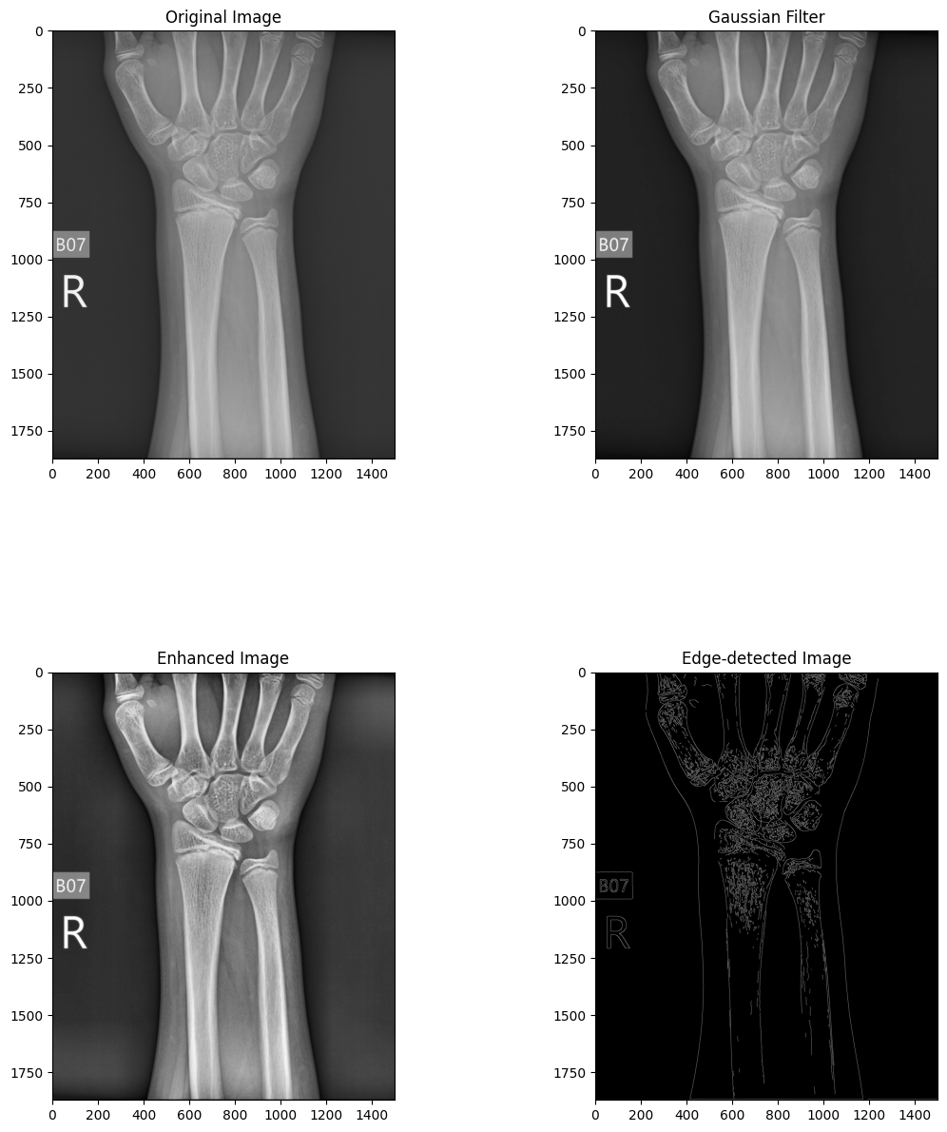
RESULTS & ANALYSIS
A. Pre-Processing

Slide 14
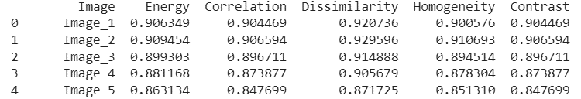
B. Feature Extraction

Slide 15
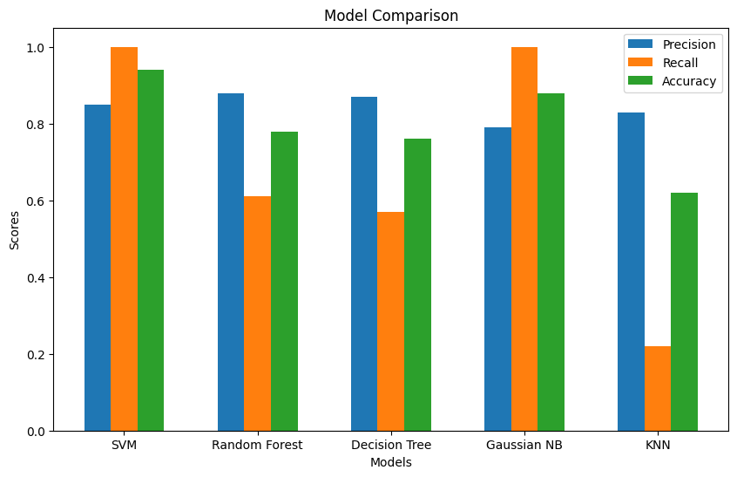
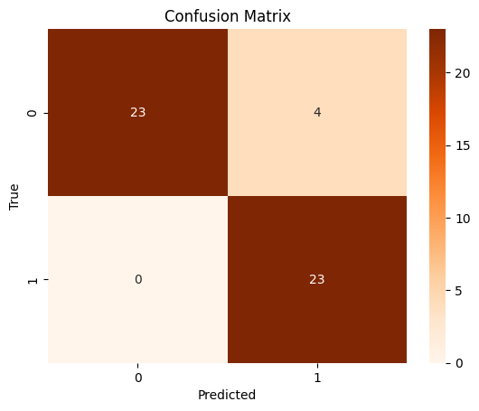
C. Classification
Model | Precision | Recall | Accuracy
SVM | 0.85 | 1.0 | 0.94
Random Forest | 0.88 | 0.61 | 0.78
Decision Tree | 0.87 | 0.57 | 0.76
Gaussian NB | 0.79 | 1.0 | 0.88
KNN | 0.83 | 0.22 | 0.62

Slide 16
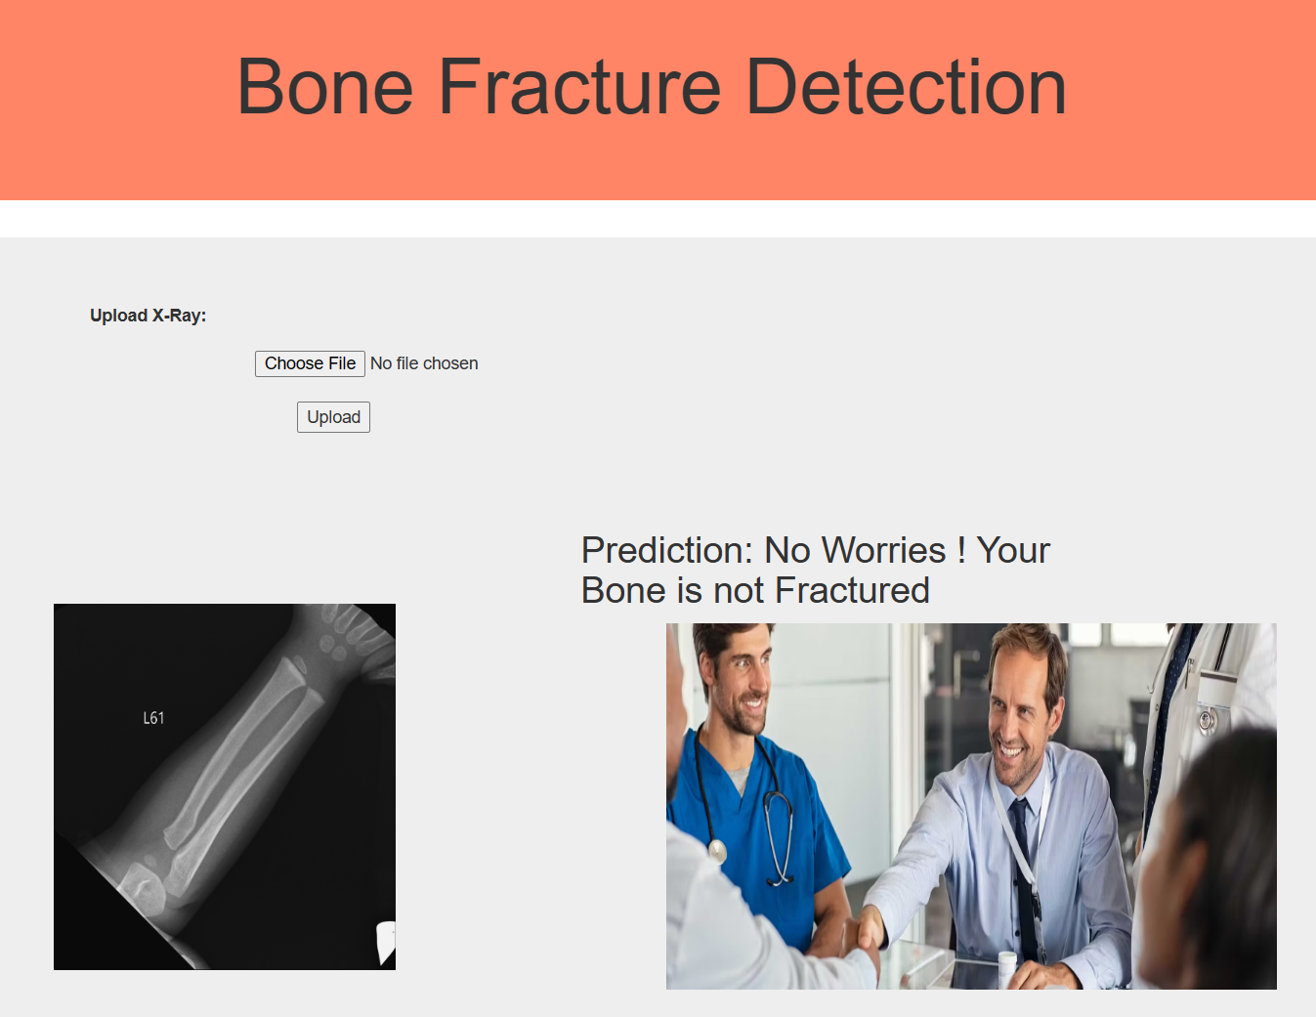
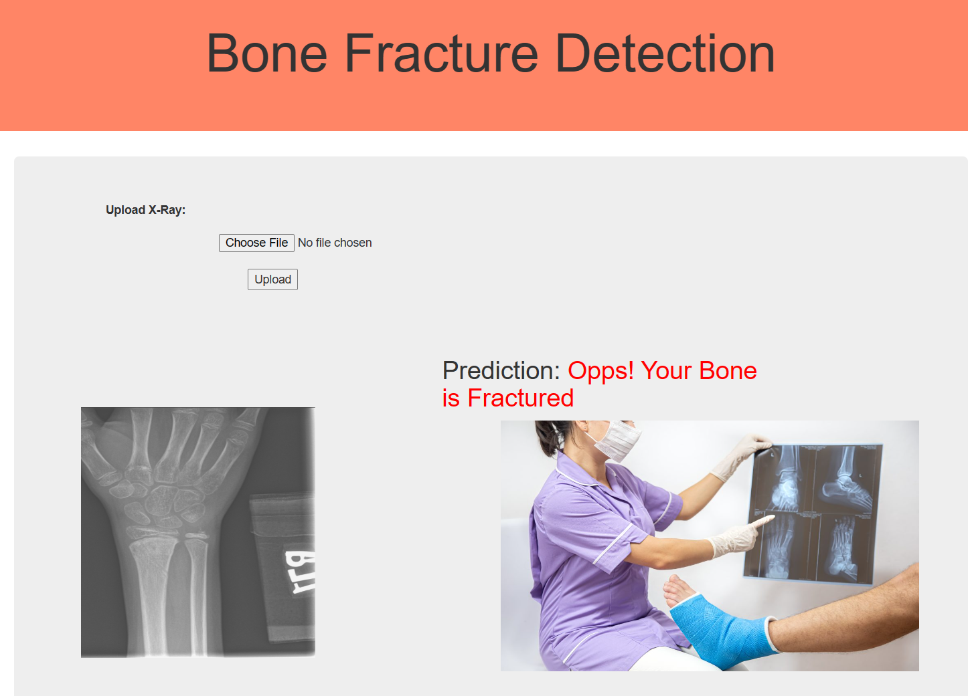
D. User Interface

Slide 17
CONCLUSION and FUTURE SCOPE
Developed a system to detect wrist bone fractures.
Enhanced fracture detection for quicker and better patient care.
The new system holds promise for improved fracture detection, benefiting patient recovery.
Explore detecting fractures in more body parts.
Implement deep learning methods for more accurate fracture detection.
Display the size of the fractured region for clinical use.

Slide 18
REFERENCES
W. Abbas, S. Adnan, M. Javid, F. Majeed, Lower Leg Bone Fracture Detection and Classification Using Faster RCNN for X-Rays Images, IEEE 23rd International Multitopic Conference (INMIC), 2020.
A. Al-Ghaithi, S. Al Maskari, Artificial intelligence application in bone fracture detection. Journal of Musculoskeletal Surgery and Research, J. Mach. Learn. 5 (1) (2021) 4–9.
Sami H. Ismael, Shahab W. Kareem, Firas H. Almukhta, Medical Image Classification Using Different Machine Learning Algorithms, AL-Rafidain Journal of Computer Sciences and Mathematics, 2020.
about the use and safety of CT scans, in: Mayo Clinic Proceedings, 2015. Amin Salih Mohammed Hersh, A. Muhamad, Shahab Wahhab Kareem, A Deep Learning Method for Detecting Leukemia in Real Images, NeuroQuantology, 2022.
P. Cephas, H. Hepzibah, A robust approach for detection of the type of fracture from X-ray images, International Journal of Advanced Research in Computer and Communication Engineering (2015).

Slide 19

QUESTIONS and ANSWERS

Slide 20

ACKNOWLEGEMENTS

